Slide 1
Chapter 2. Some Circuit Simplification Techniques

Slide 2
Contents
2.1 Superposition Theorem
2.2 Source Transformation
Goal: Use these two theorems to simplify circuits

Slide 3
2.1 Superposition Theorem

Slide 4
Superposition Theorem
If a linear circuit is excited by more than one independent source, the total response is the algebraic sum of all the individual responses.
The individual response is the result of an independent source acting alone.

Slide 5
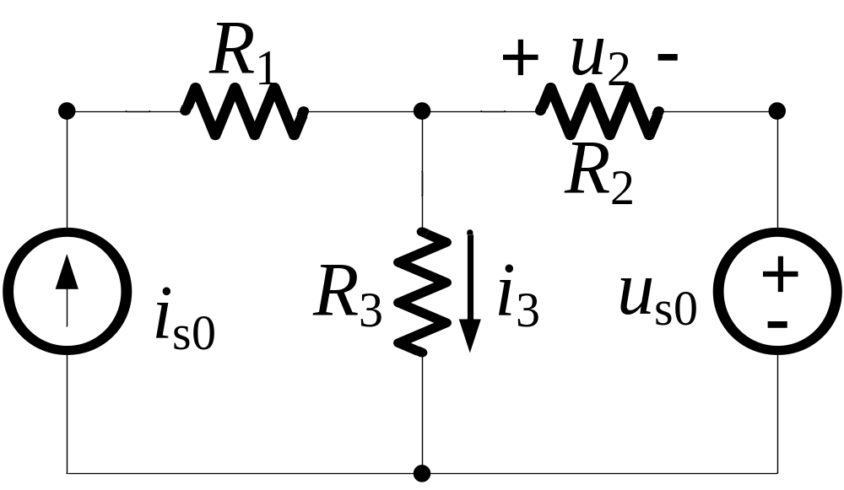
Excitation and Response
Response
Excitation

Slide 6
Comments on Superposition
Act alone:
  Consider each independent source one at a time;
  Other independent sources are “killed”, or “turned off”, or “zeroed out”.

Slide 7
Comments on Superposition
If a voltage source is zeroed out, it is treated as a short circuit;
If a current source is zeroed out, it is treated as an open circuit;
Superposition theorem does not apply to power calculation.

Slide 8
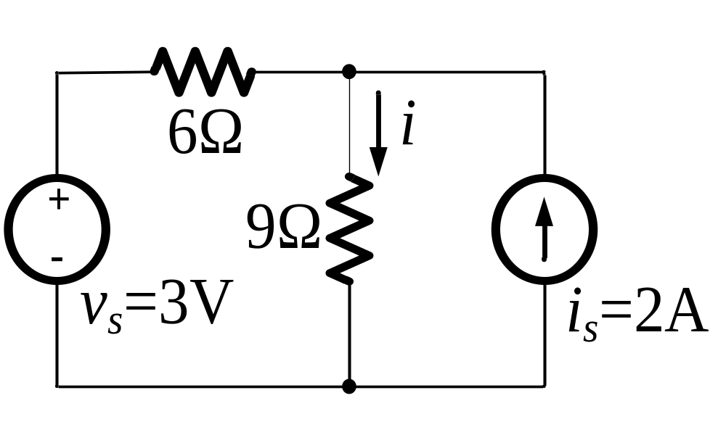
Example 1
Find the unknown branch current i.

Slide 9
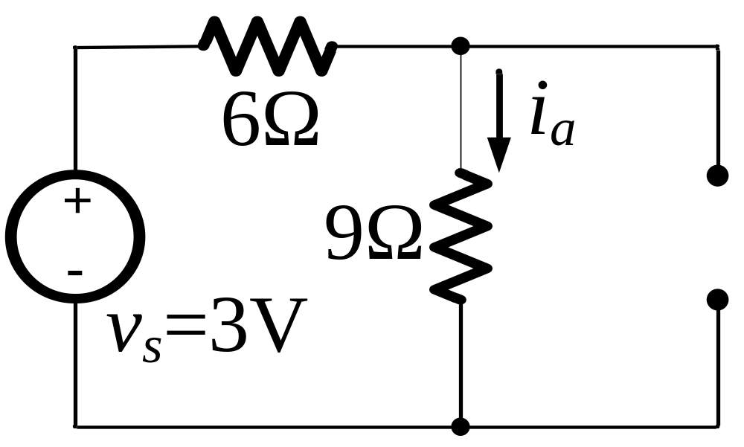
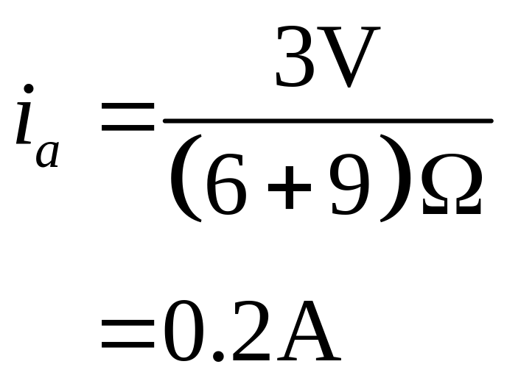
Solution
Set the current source to be zero:

Slide 10
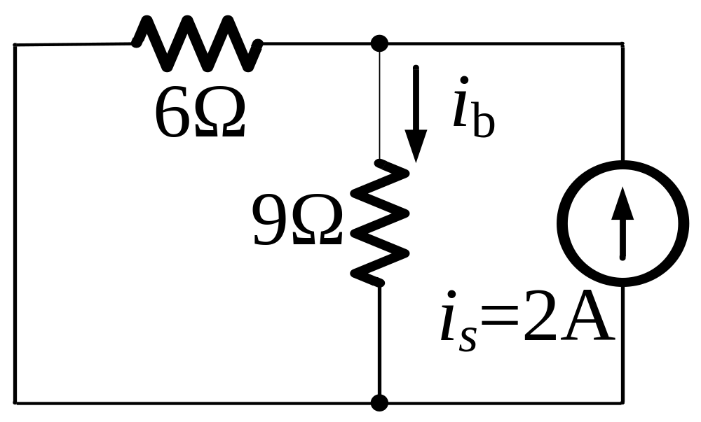
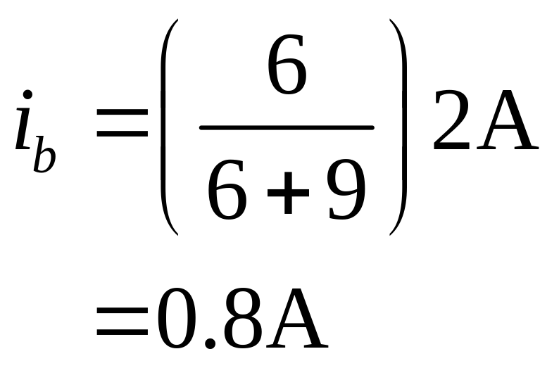
Set the voltage source to be zero:

Slide 11
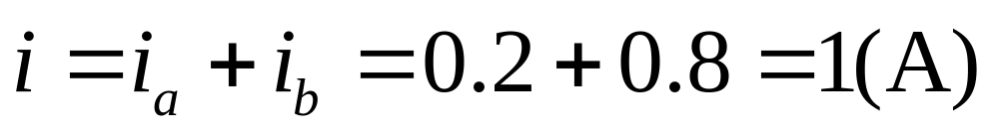
By superposition, we have:

Slide 12
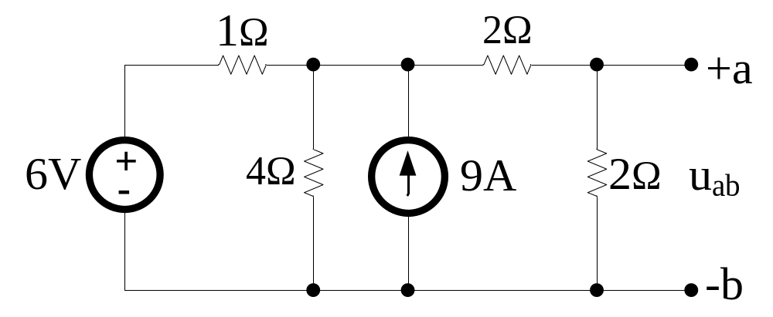
Example 2
Use superposition theorem to find the voltage uab in the circuit.

Slide 13
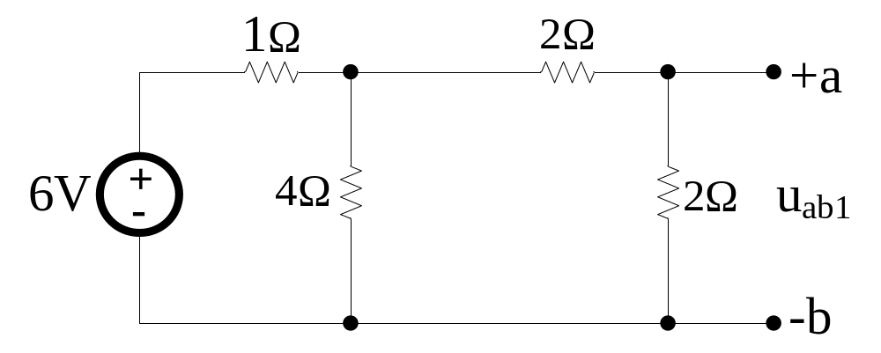
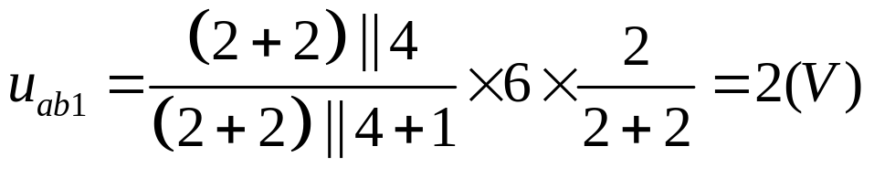
Solution
First, turn off the current source,

Slide 14
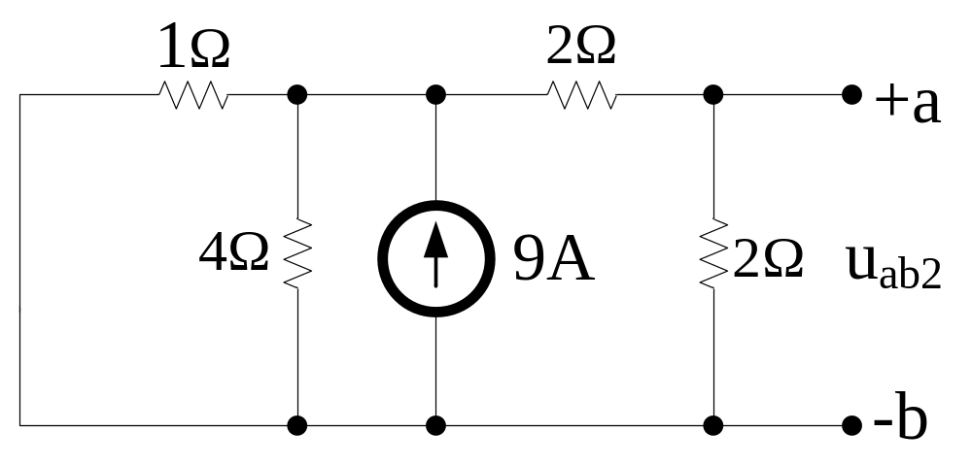
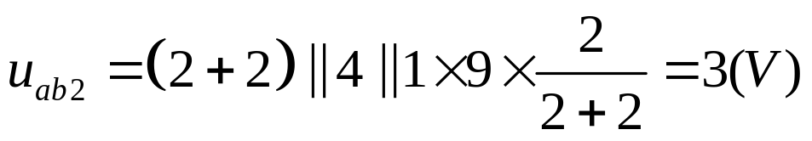
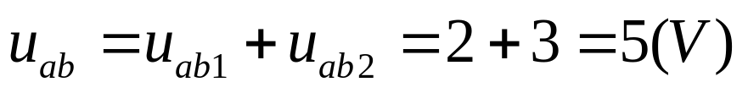
Second, turn off the voltage source
The last step, add uab1 and uab2 together

Slide 15
2.2 Source Transformation

Slide 16
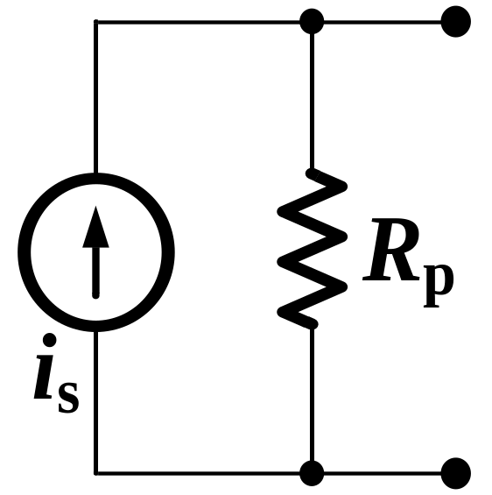
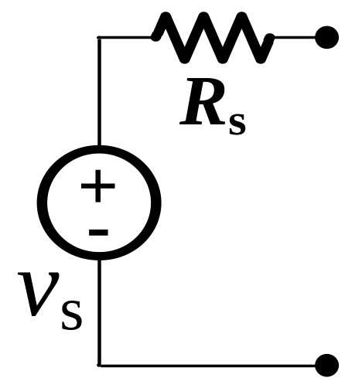
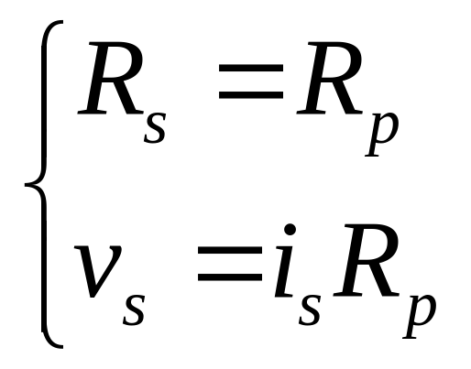
Source Transformation
a
a
Equivalent
b
b

Slide 17
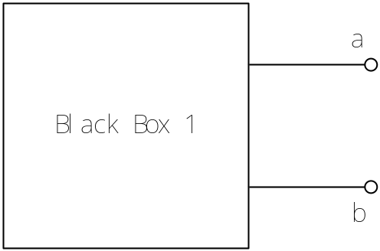
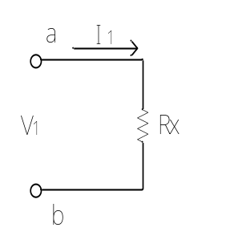
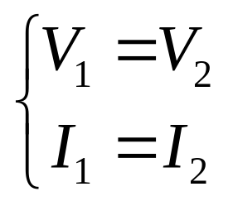
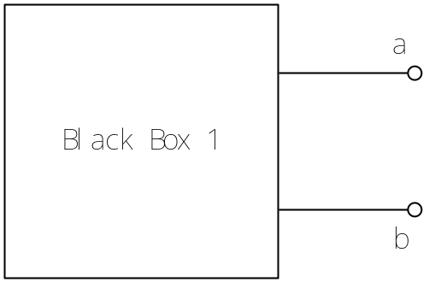
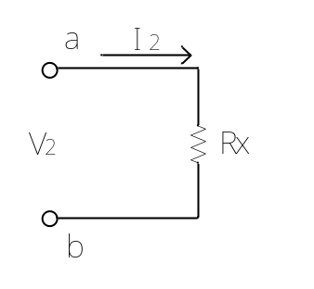
What is equivalent?
For two 2-terminal Black Boxes,
Whatever the load Rx=? If these equations always satisfied
We say these two Black Boxes are equivalent

Slide 18
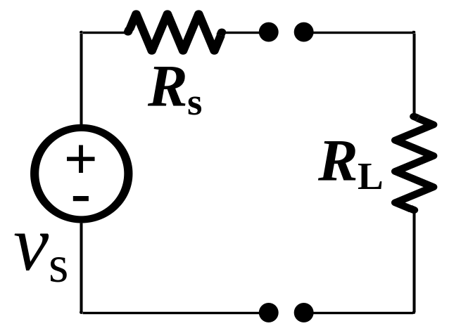
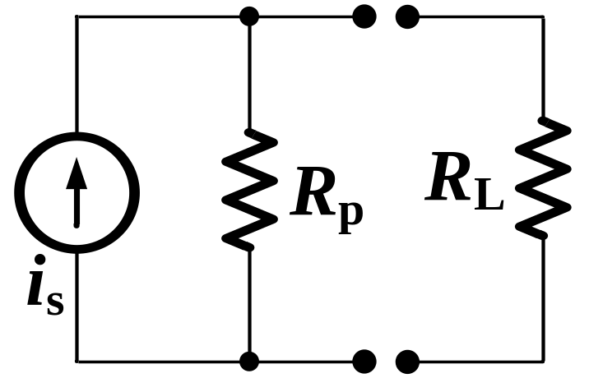
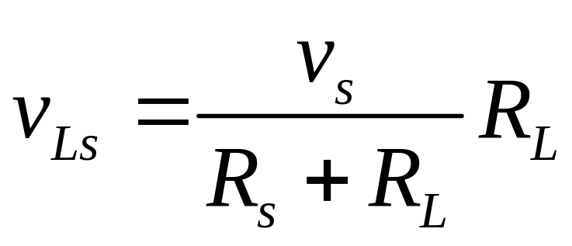
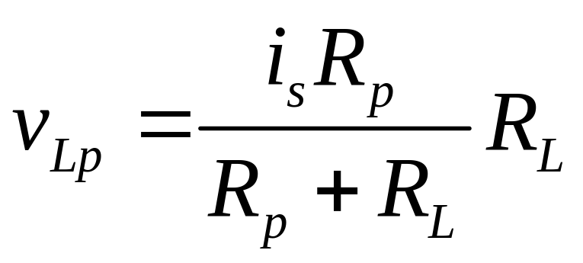
Source Transformation
a
a
Equivalent
b
b
=

Slide 19
Source Transformation
=

Slide 20
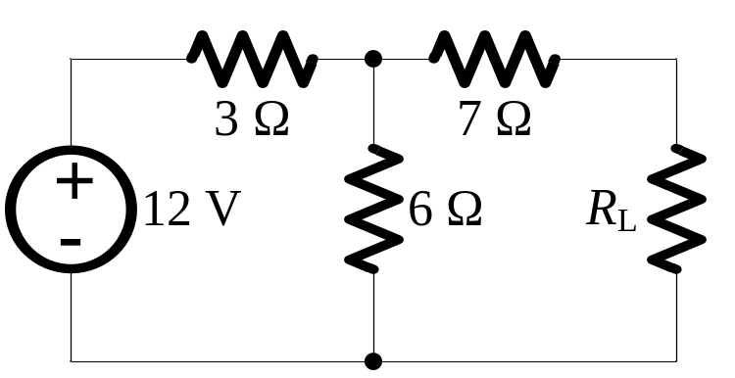
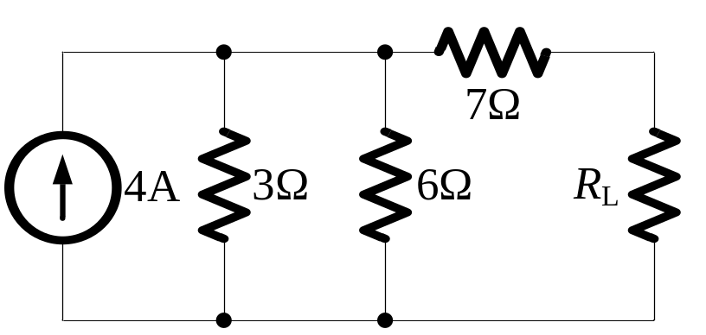
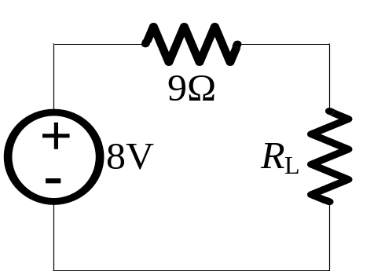
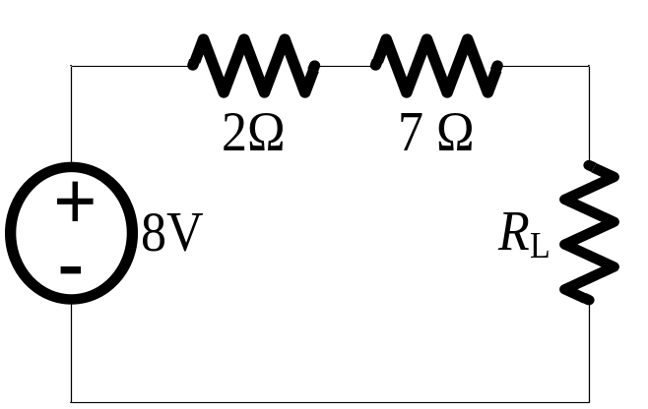
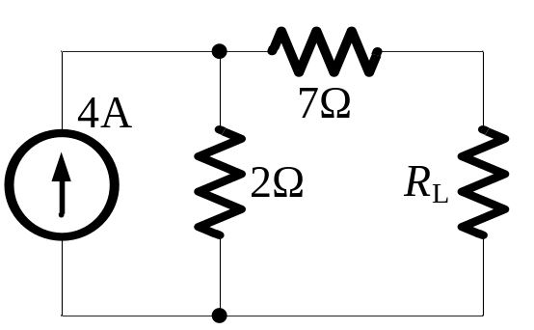
Example 1
NOTE the reference direction of voltage and current sources.

Slide 21
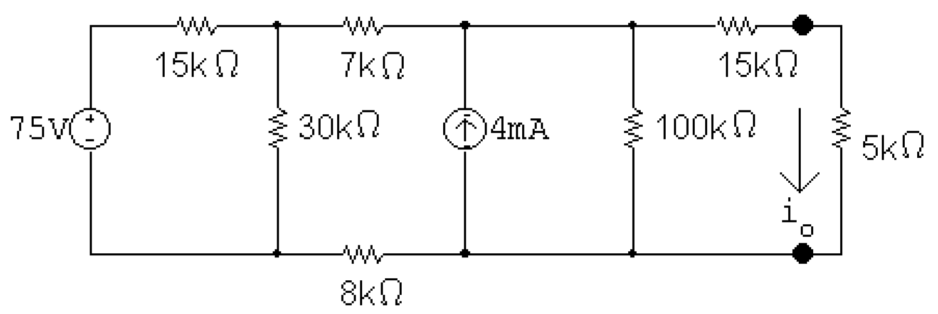
Example 2
Find the current in the 5 kΩ resistor by source transformations.
ANS: i₀ = 3mA

Slide 22
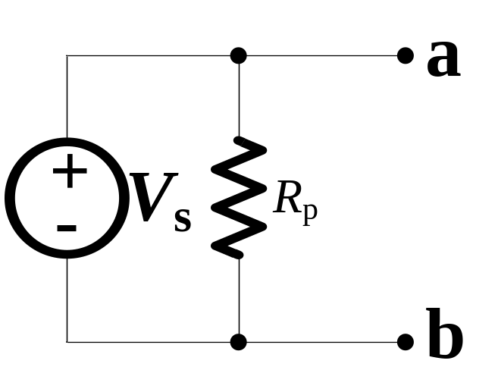
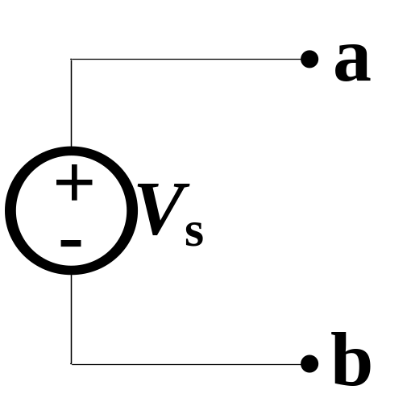
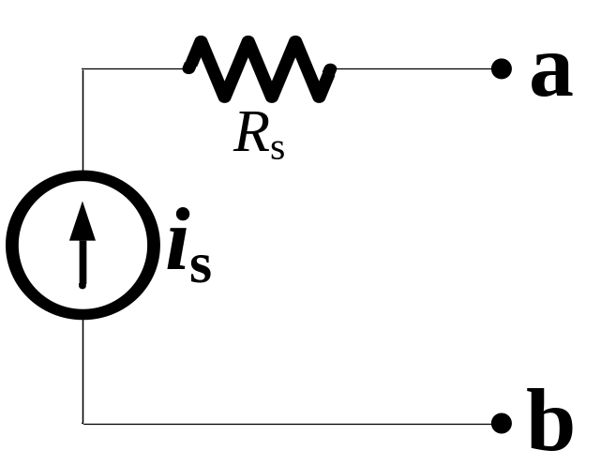
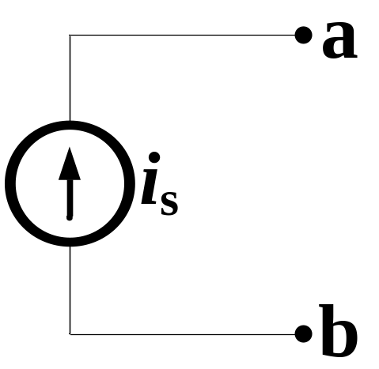
Special Cases of Source Transformation

Slide 23
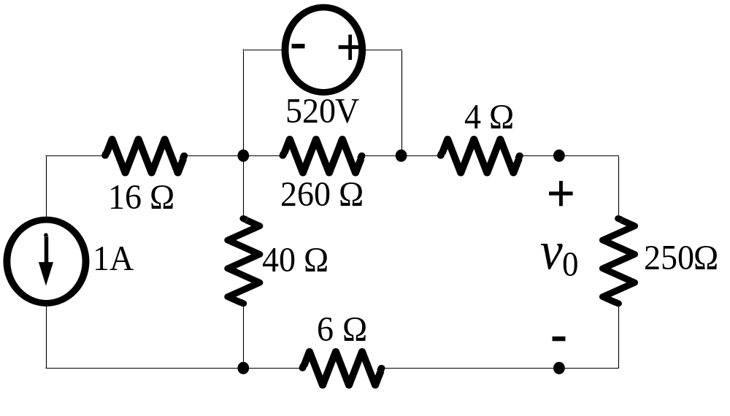
Example 3
Use source transformation to find v₀.

Slide 24
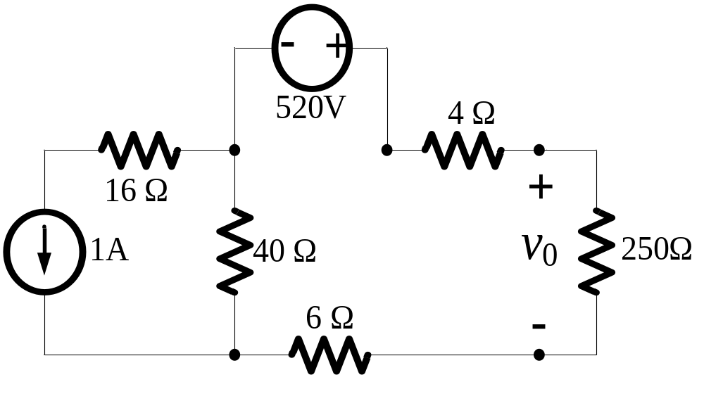
Solution:
ANS: v₀ = 400V

